Slide 1
HOUSING: PRICE PREDICTION
Aaron Dsouza

Slide 2
Agenda / Topics
Problem Definition
Data Analysis
EDA (Exploratory Data Analysis)
Pre-processing Pipeline
Building Machine Learning Models
Concluding Remarks

Slide 3
Problem Definition
Houses are one of the necessary need of each and every person around the globe and therefore housing and real estate market is one of the markets which is one of the major contributors in the world’s economy.
Data science comes as a very important tool to solve problems in the domain to help the companies increase their overall revenue, profits, improving their marketing strategies and focusing on changing trends in house sales and purchases.
Real estate is the least transparent industry in our ecosystem. Housing prices keep changing day in and day out and sometimes are hype rather than being based on valuation. Predicting housing prices with real factors is the main crux of our project.

Slide 4
Data Analysis
As an aspiring Data Scientist the goal is to create a model that will predict the house prices with the available independent variables.
This model will then be used by the management to understand how exactly the prices vary with the variables.
The company can accordingly manipulate the strategy of the firm and concentrate on areas that will yield high returns. Further, the model will be a good way for the management to understand the pricing dynamics of a new market.

Slide 5
Data Analysis
The sample data is provided to us from our client database.
A total of three data types in the data set Float, Int and Object.
The data provided was well organized structured data in .CSV (comma-separated values) format.
The data set has a total of 81 columns

Slide 6
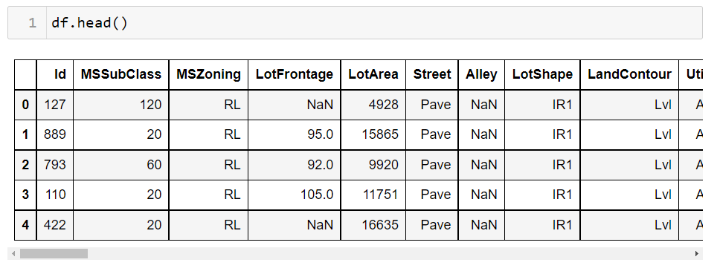
Data Analysis
Sample of Data Frame

Slide 7
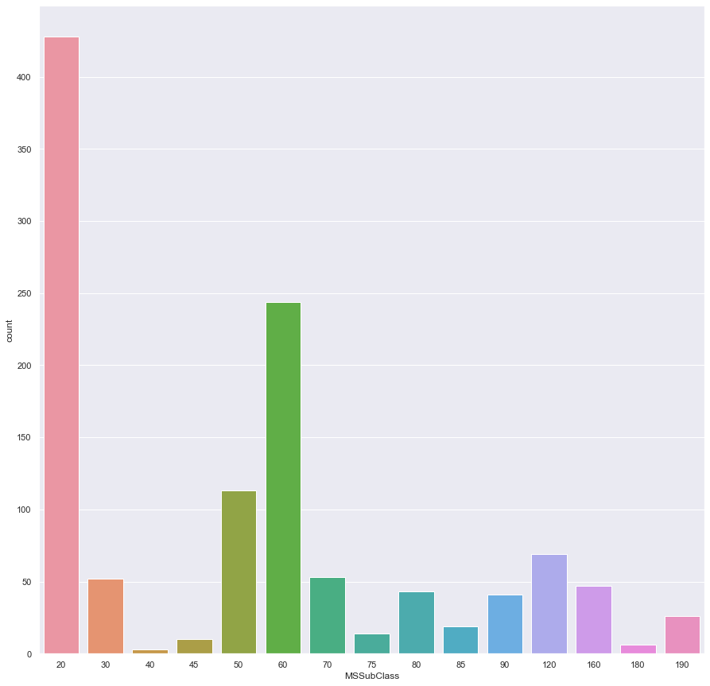
EDA (Exploratory Data Analysis)
MSSubClass count plot
MSSubClass Identifies the type of dwelling(a house, flat, or other place of residence) involved in the sale.
20 (1-STORY 1946 & NEWER ALL STYLES) is the most acquainted dwelling.
40 (1-STORY W/FINISHED ATTIC ALL AGES) is the least acquainted dwelling.

Slide 8
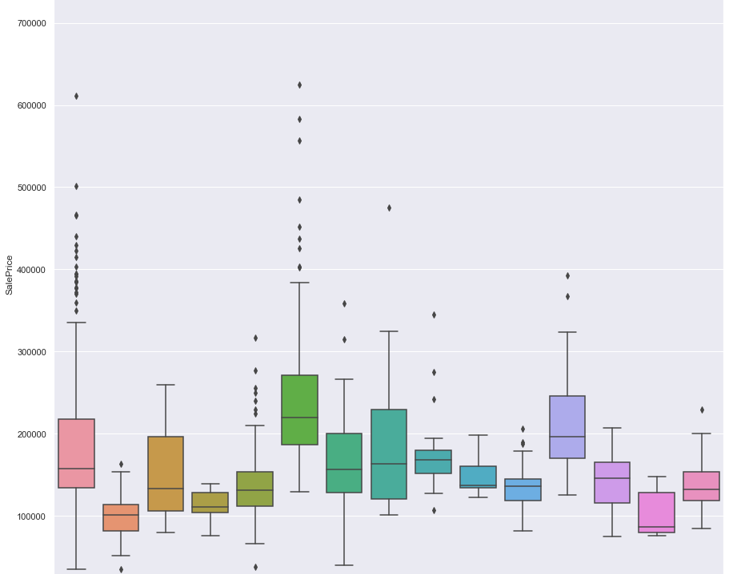
EDA (Exploratory Data Analysis)
Ms-subclass vs Sales Price
The dwelling type 60 (2-STORY 1946 & NEWER) in terms of price is the most expensive one.
30 (1-STORY 1945 & OLDER) type dwelling is the cheapest one
Basically Newer dwelling more expensive than older dwelling.

Slide 9
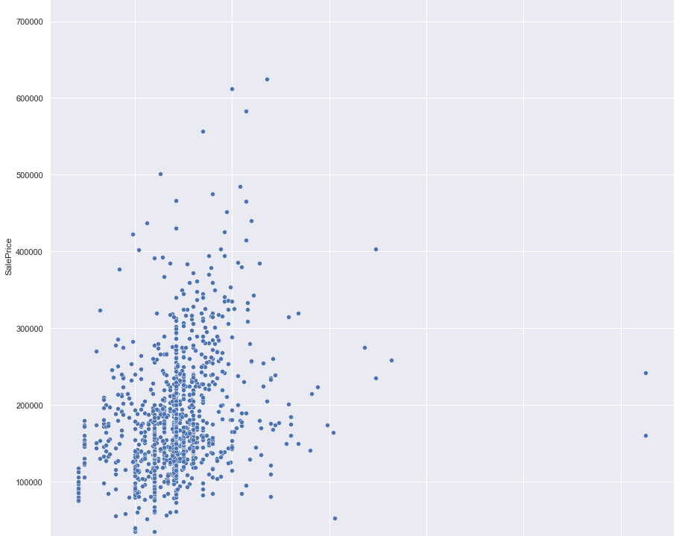
EDA (Exploratory Data Analysis)
Fig.37(Lot Frontage vs Sales Price)
Most of the houses in price range 100000$, 300000$ are having Linear feet of street connected to property between (25 feet to 100 feet)
There are some very expensive houses with Lot Frontage range between(100 feet to 200 feet)

Slide 10
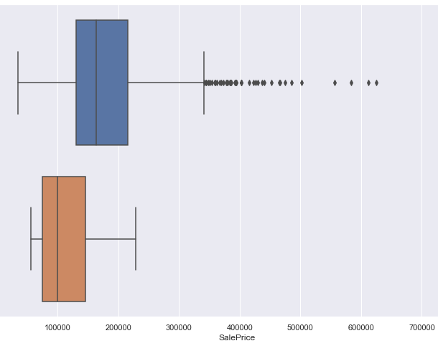
EDA (Exploratory Data Analysis)
Fig.38(Street vs Sales Price)
The fig.38 is a box plot which shows the relationship between type of street and sales price, from the plot we can say that The Paved type of road access to property is more expensive then Gravel type of roads

Slide 11
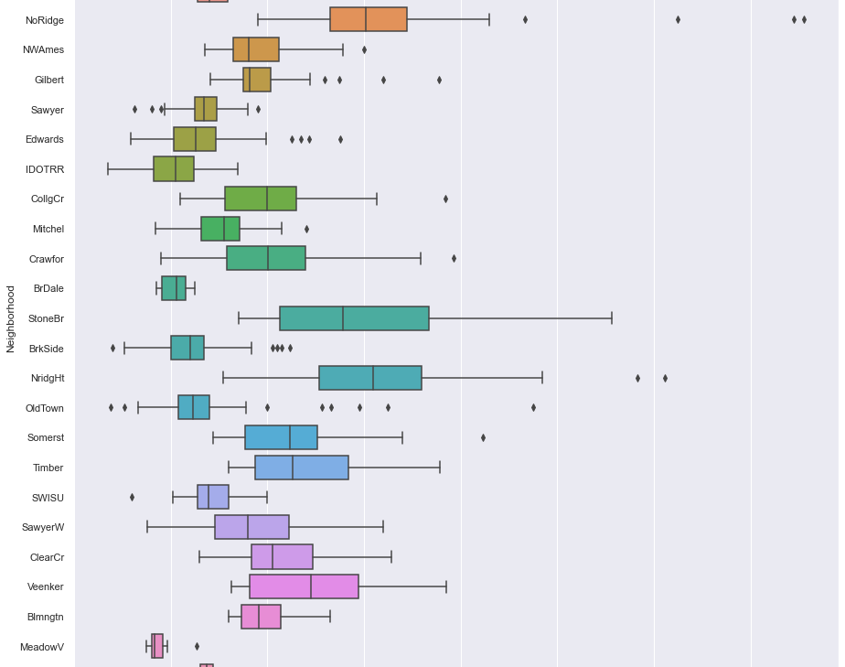
EDA (Exploratory Data Analysis)
Fig.39(Neighbourhood vs Sales Price)
Neighbourhood (Physical locations within Ames city limits) NridgHt (Northridge Heights) is the most expensive location and will have a heavy impact on house price

Slide 12
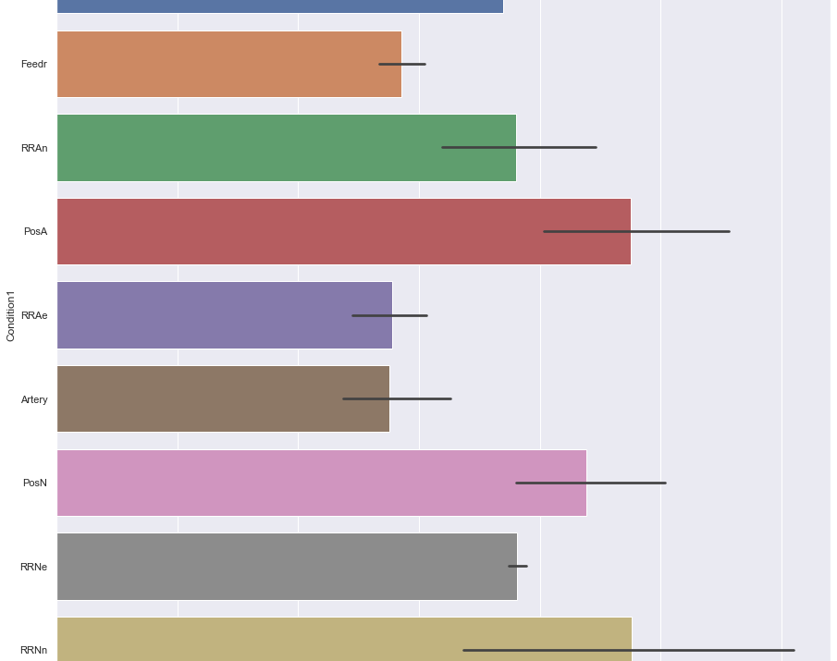
EDA (Exploratory Data Analysis)
Fig.40(Condition1 vs Sales Price)
Condition1 (Proximity to various conditions) RRNn (Within 200' of North-South Railroad) and PosA (Adjacent to positive off-site feature) are the two conditions which are an expensive choice for an average customer. This conditions will impact the sale price of houses.

Slide 13
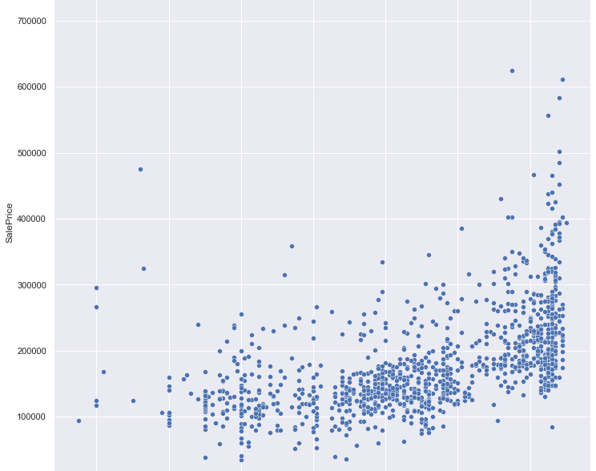
EDA (Exploratory Data Analysis)
Fig.41(Year Built vs Sales Price)
The house will be more expensive if it was built latterly. More recently built houses will always be more expensive.

Slide 14
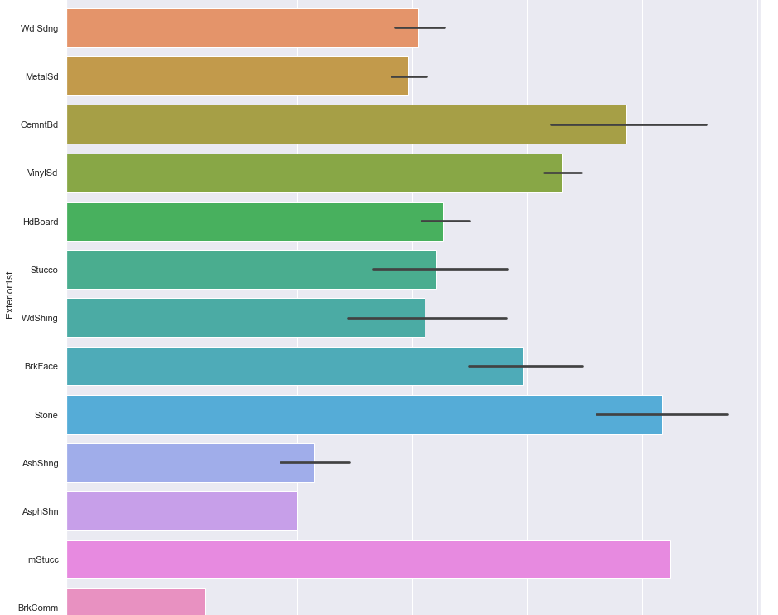
EDA (Exploratory Data Analysis)
Fig.42(Exterior1st vs Sales Price)
Exterior1st is Exterior covering on house in terms of expenses houses with Exterior covering ImStucc (Imitation Stucco) are very expensive as compared to other Exterior coverings. Brick Common is the cheapest Exterior covering.

Slide 15
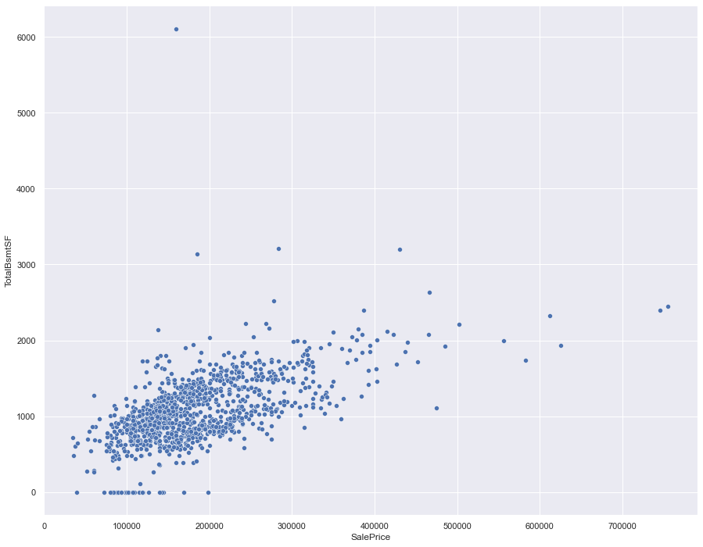
EDA (Exploratory Data Analysis)
Fig.43(TotalBsmtSF vs Sales Price)
Basements with more area will evidently be more expensive.

Slide 16
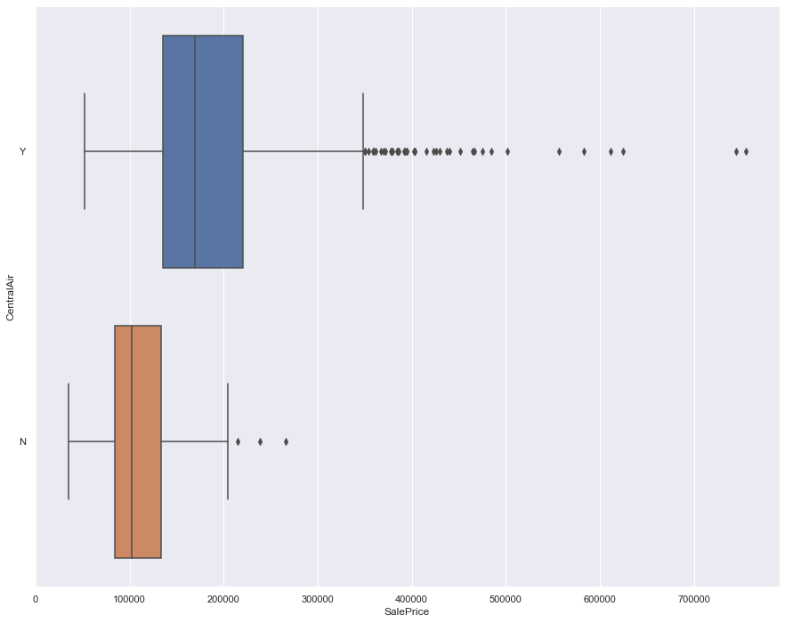
EDA (Exploratory Data Analysis)
Fig.44(Central Air vs Sales Price)
Houses with Central air conditioning will be more expensive.

Slide 17
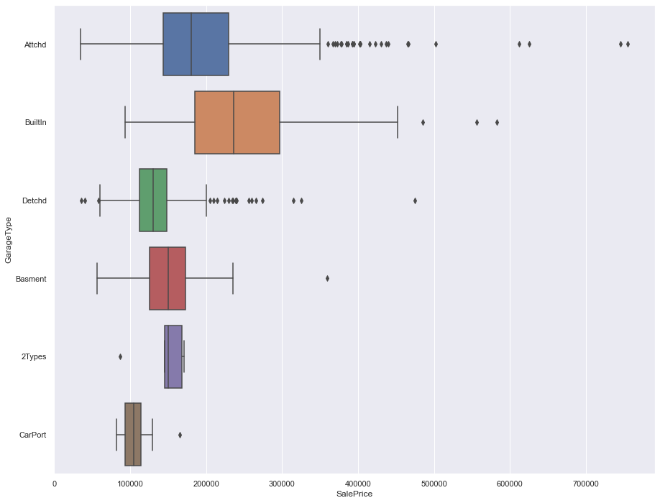
EDA (Exploratory Data Analysis)
Fig.44(Garage vs Sales Price)
Houses with Built-in Built In (Garage part of house – typically has room above garage) will be more expensive

Slide 18
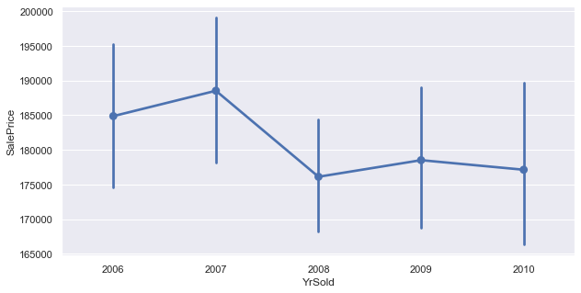
EDA (Exploratory Data Analysis)
Fig.45(Yrsold vs Sales Price)
In 2007 House sale prices were very high as compared to all other years.

Slide 19
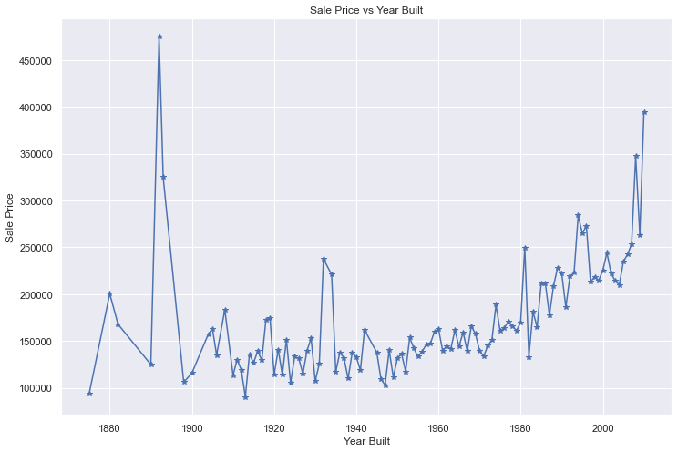
EDA (Exploratory Data Analysis)
Fig.45(Ybuilt vs Sales Price)
Some of the houses around the year 1900 are very expensive.
The newer the house the more expensive it will be.

Slide 20
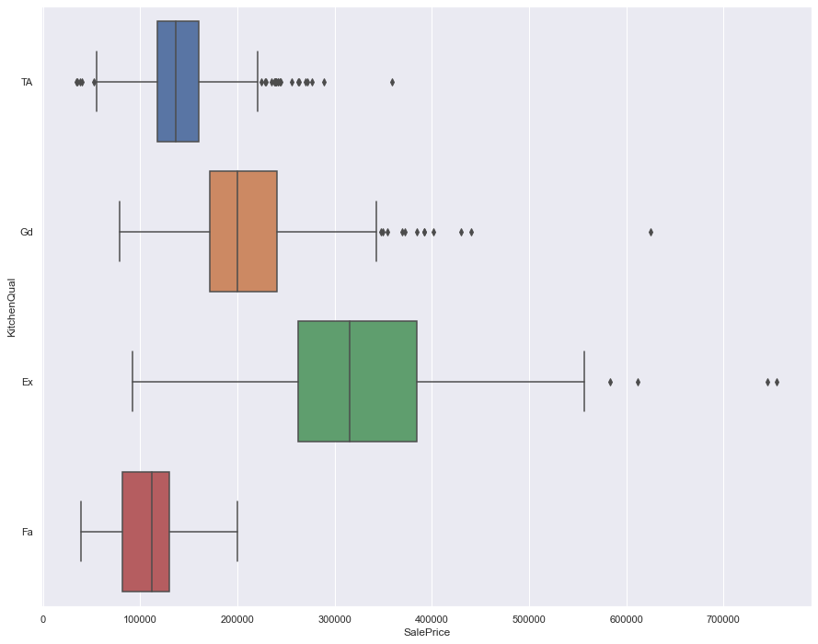
EDA (Exploratory Data Analysis)
Fig.46(Kitchen Quality vs Sales Price)
Houses with Kitchen Quality (Excellent) will be more expensive.

Slide 21
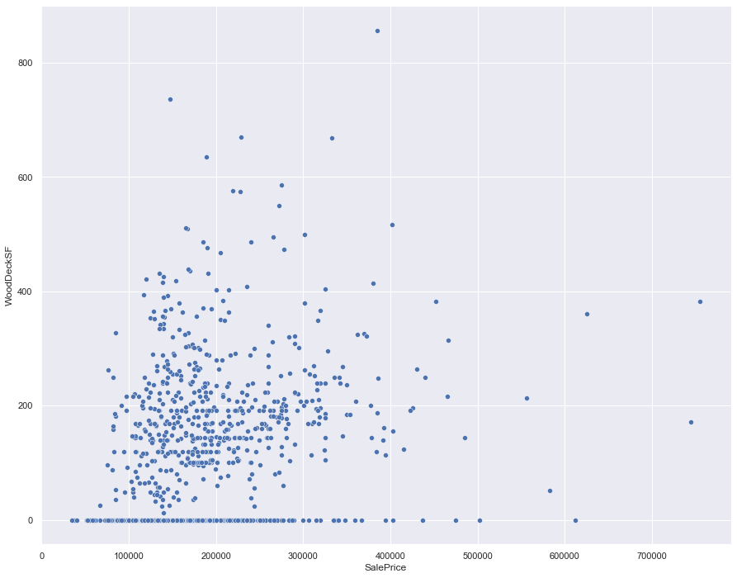
EDA (Exploratory Data Analysis)
Fig.47(Wood Deck SF vs Sales Price)
We can clearly observe that, with more Wood deck area per square feet the total selling price of the house increases.

Slide 22
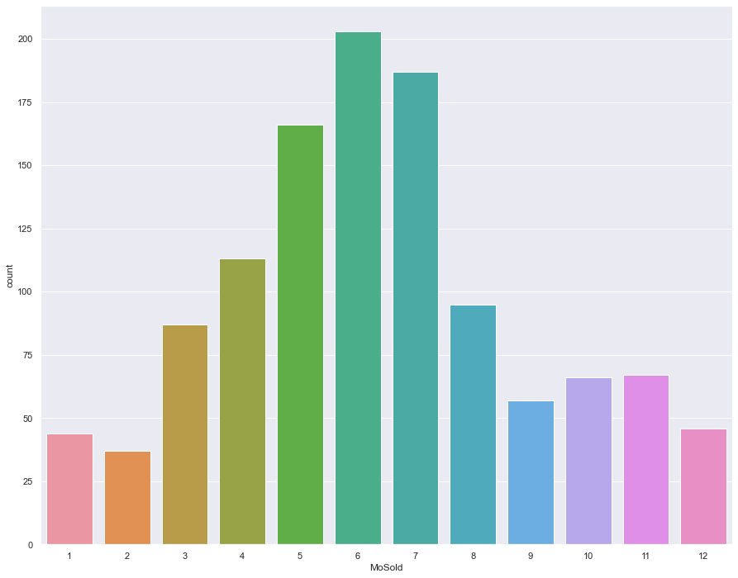
EDA (Exploratory Data Analysis)
Fig.48(Month Sold)
Highest number of Houses were sold in the month of June and July.

Slide 23
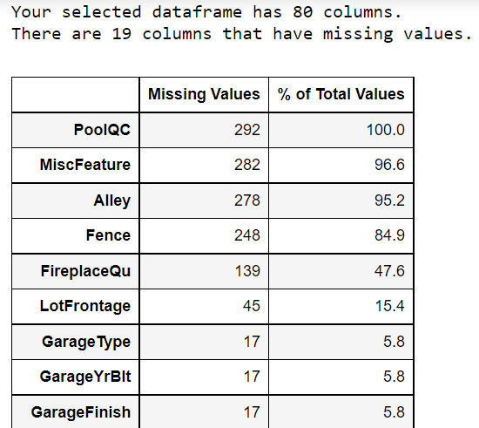
Pre-processing Pipeline
Sample of some of the Null values in the data set.

Slide 24
Pre-processing Pipeline
There were no duplicated values in the dataset.
We can drop the Id column as it has no special significance in predicting the house prices.
We can drop PoolQC, Fence, Alley and MiscFeature columns as they have more then 75 % of missing data.

Slide 25
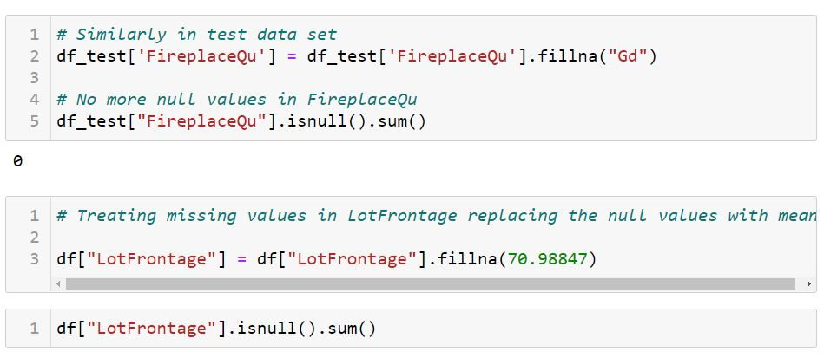
Pre-processing Pipeline
Most of the missing values were replaced with mean , median and mode of the data if the variable was continuous in nature then it was replaced by (Mean or Median) and if the data was categorical it was replaced by mode of the data. Similar steps were followed for test data.

Slide 26
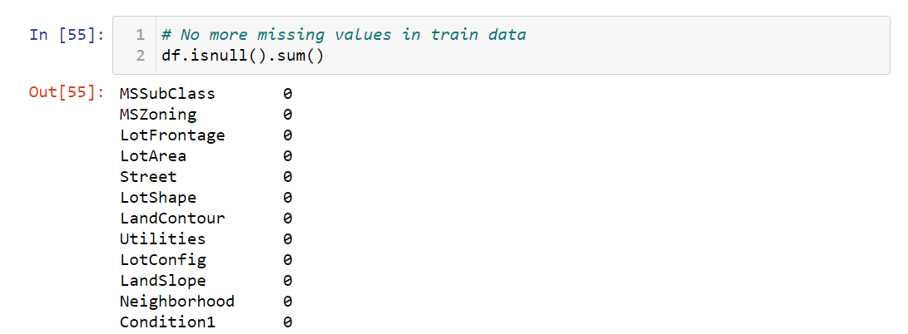
Pre-processing Pipeline
No more null values

Slide 27
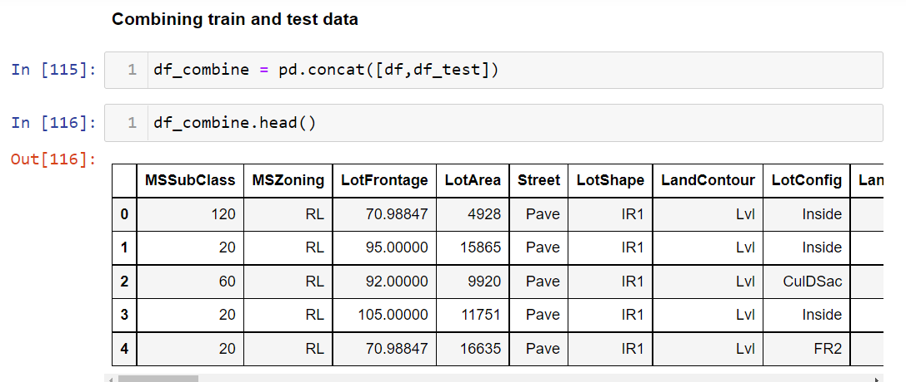
Pre-processing Pipeline
The train and test data was combined in order to perform further pre-processing.

Slide 28
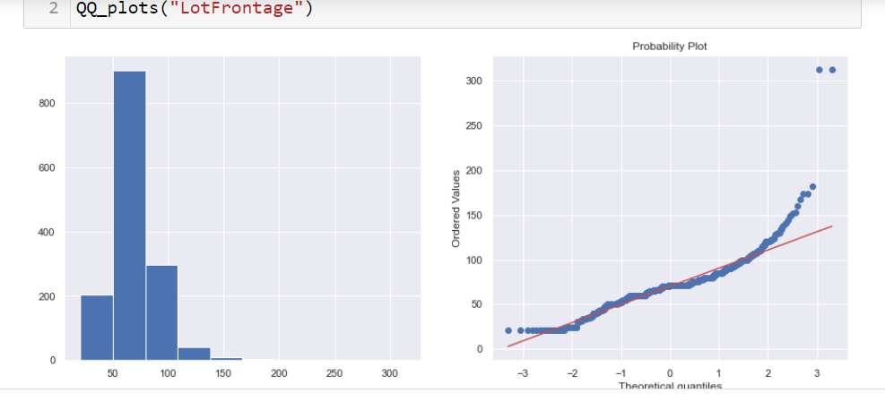
Pre-processing Pipeline
Using Histograms, QQ Plots and Box Plots to understand the distribution of data, to know if the data was Normal , Skewed or Highly Skewed.

Slide 29
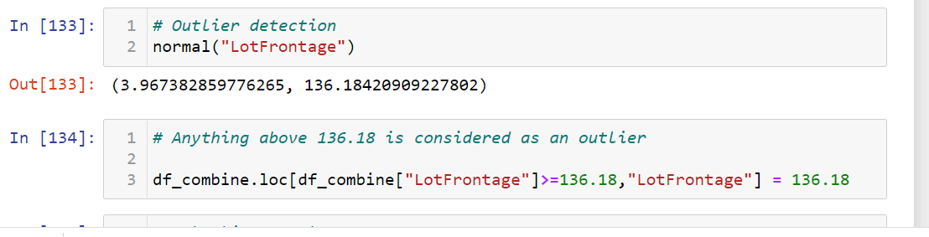
Pre-processing Pipeline
Handling Outliers in the features

Slide 30
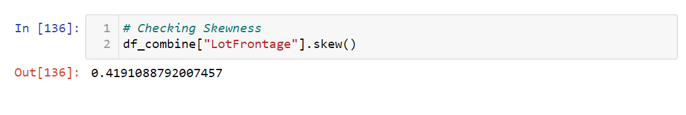
Pre-processing Pipeline
If the skewness of the data is still high after outlier removal then various transformation methods are used to reduce skewness like Log Transformation, reciprocal Transformation, Square root and exponential Transformation.

Slide 31
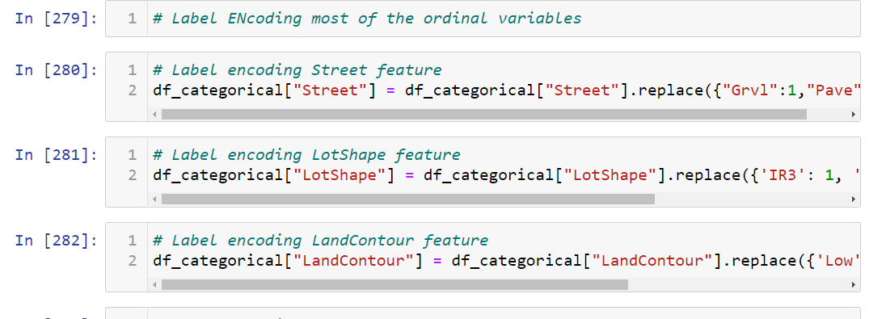
Pre-processing Pipeline
After Handling transformations and outliers Continuous and categorical data is separated in order to perform encoding on categorical data.

Slide 32
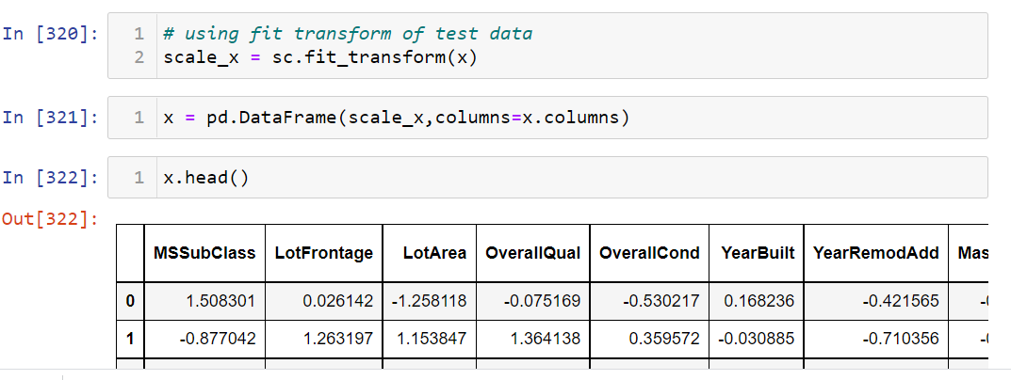
Pre-processing Pipeline
Using Sklearn’s Standard Scaler to scale the data

Slide 33
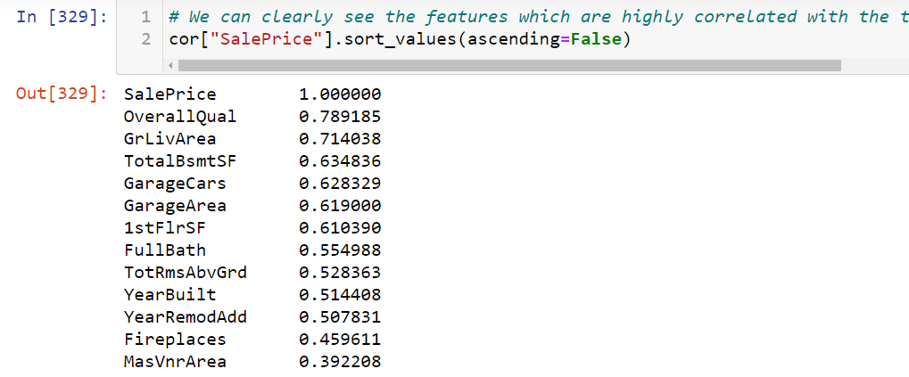
Pre-processing Pipeline
Highly correlated features with the target variable (Sale Price)

Slide 34
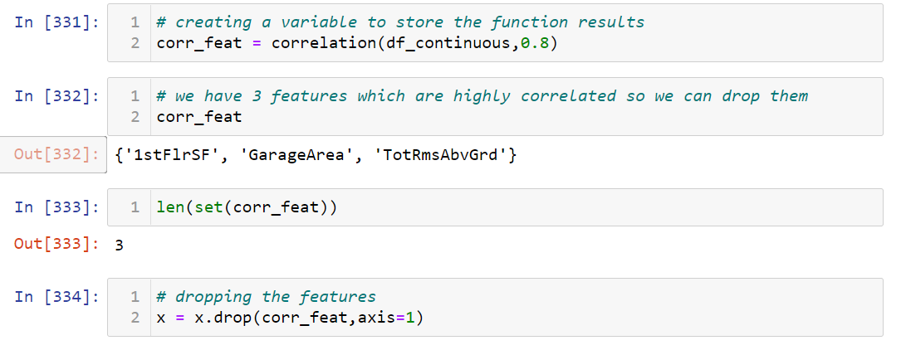
Pre-processing Pipeline
No we need to remove some features which are highly correlated to each other, removing features which have more than 80 % correlation between them.

Slide 35
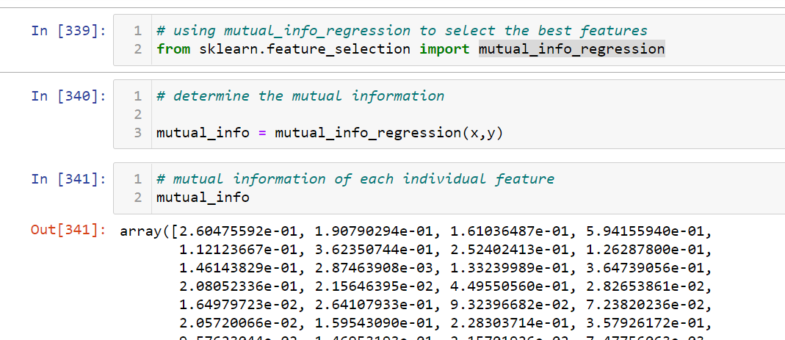
Pre-processing Pipeline
Using mutual info regression from sk-learn’s feature selection library to find out the features with high weight-age

Slide 36
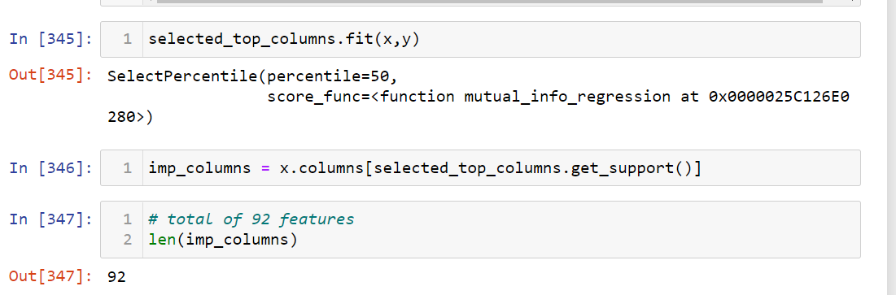
Pre-processing Pipeline
Using Select Percentile from sk-learn’s feature selection library to find
find top 50% of the most important features which impact the Sale Price of the house

Slide 37
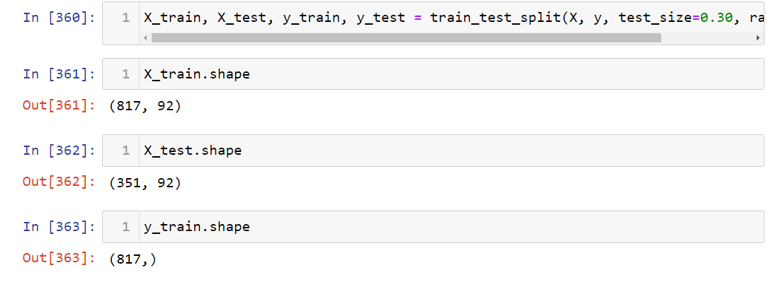
Pre-processing Pipeline
Sklearn’s Train Test split was used. And the initial random state was taken as zero.

Slide 38
Building Machine Learning Models
A total of 8 regression models were used in order to predict the target variable Sale Price.
Linear Regression.
Random Forest Regression.
Bagging Regressor.
XGB Regressor.
ADA Boost Regressor.
Regularization(Lasso).
Regularization(Ridge)
Gradient Boosting Regressor.

Slide 39
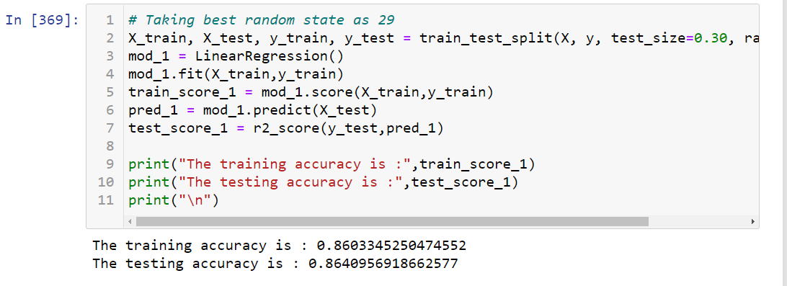
Building Machine Learning Models
Linear Regression

Slide 40
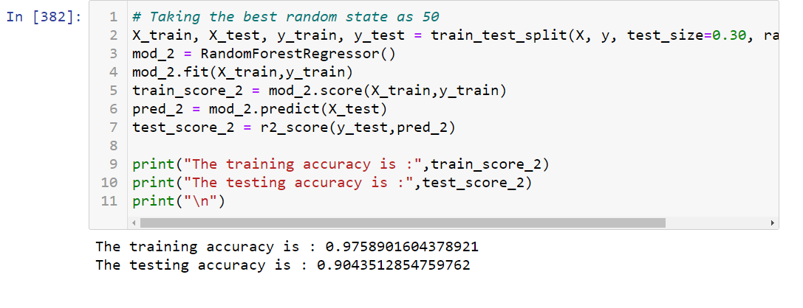
Building Machine Learning Models
Random Forest Regression.

Slide 41
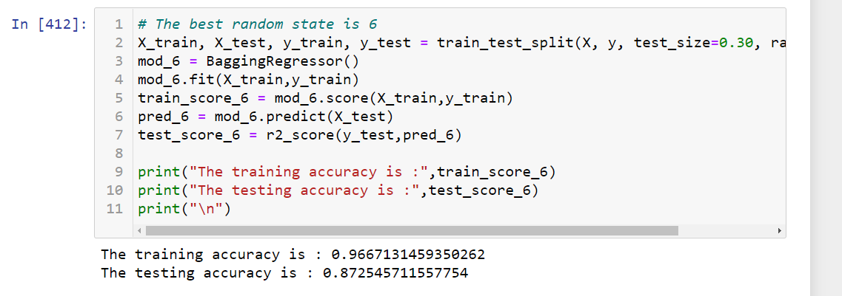
Building Machine Learning Models
Bagging Regressor.

Slide 42
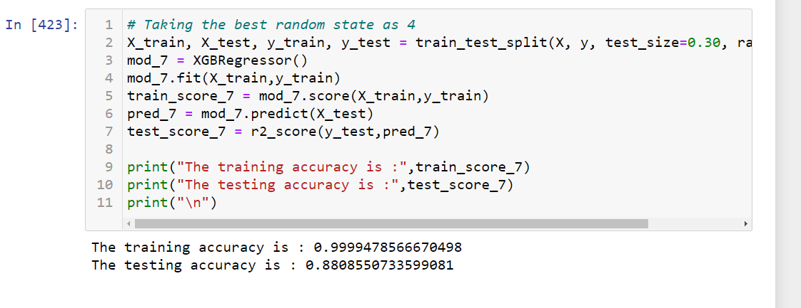
Building Machine Learning Models
XGB Regressor.

Slide 43
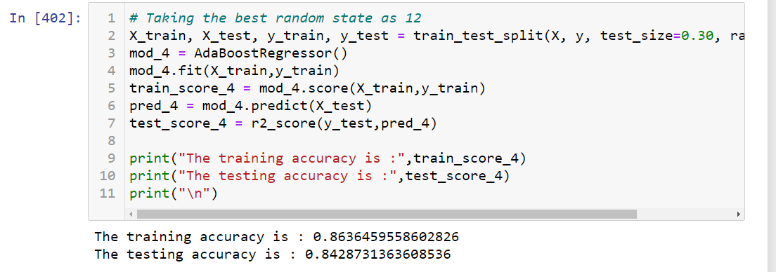
Building Machine Learning Models
ADA Boost Regressor.

Slide 44
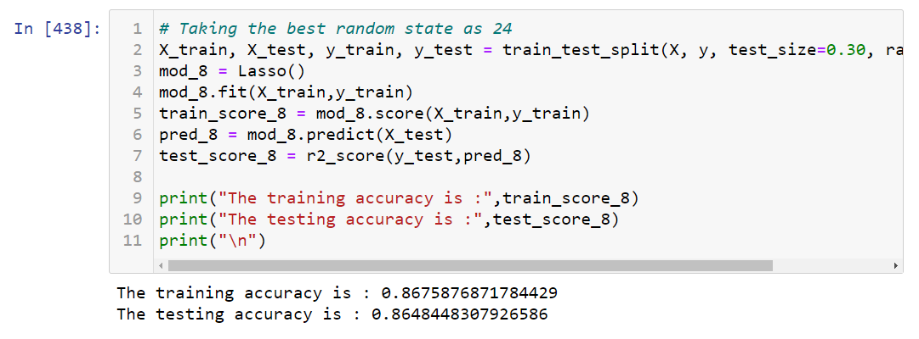
Building Machine Learning Models
Regularization(Lasso).

Slide 45
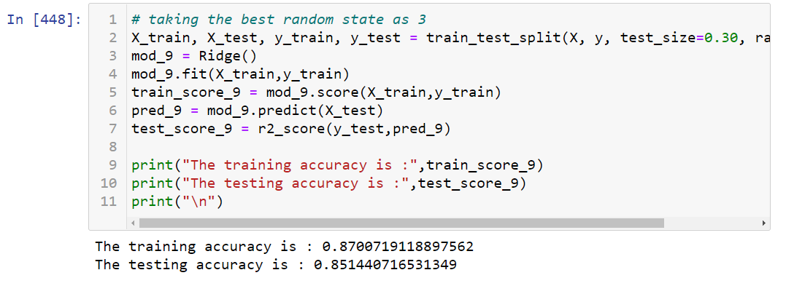
Building Machine Learning Models
Regularization(Ridge)

Slide 46
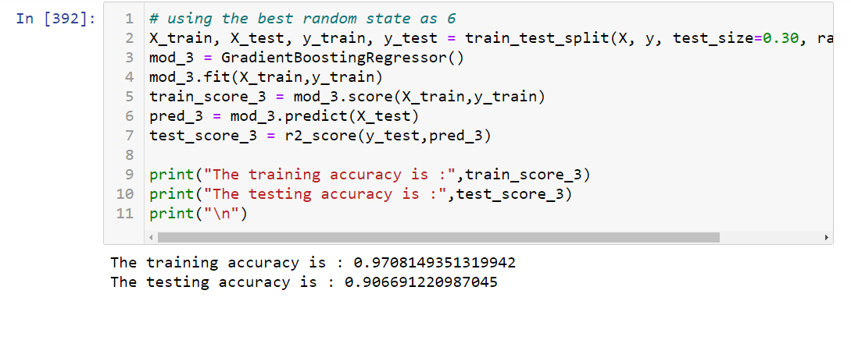
Building Machine Learning Models
Gradient Boosting Regressor.

Slide 47
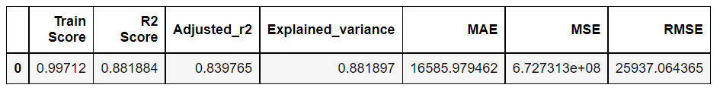
Hyper parametric Tuning
Gradient Boosting Regression(Hyper parametric Tuning)
After applying Hyper parametric Tuning for Gradient Boosting regression we get the following results:

Slide 48
Concluding Remarks
The first step I took, was to visualize the distribution of each feature and its effect on the Sale Price (dependent variable). From the analysis, I conclude that some of the most useful features for predictions were“ Overall Quality”, “GrLivArea”, “TotalBsmtSF”, “GarageCar”, “Kitchen Quality” and “Year Built”. The Gradient Boosting Regression Algorithm proved to be the best model for regression based on the Cross-Validation scores. An accuracy(r2 score) of 0.88 % was achieved by hyper parametric tuning of the model.

Slide 49
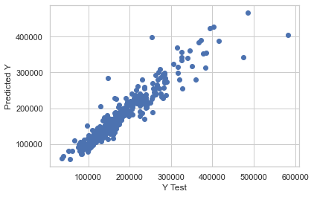
Concluding Remarks Actual values vs Predicted values

Slide 50
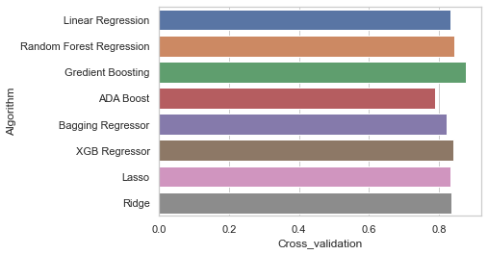
Concluding Remarks Best Performing ML Algorithm

Slide 51
Concluding Remarks
New Skills Acquired: Learned a new approach to feature engineering (mutual info regression) from sklearn’s Feature Selection Library
Algorithms Used: Linear regression, Gradient Boosting, Random Forest regression, XGB Regression, Ada Boost, Lasso Regression, Ridge Regression, Bagging regression.
Challenges Faced: The Feature Engineering ,Feature Selection and data pre-processing was quit challenging as there were a lot of non-realistic values in the dataset.

